Slide 1
Data Integration
June 3rd, 2002

Slide 2
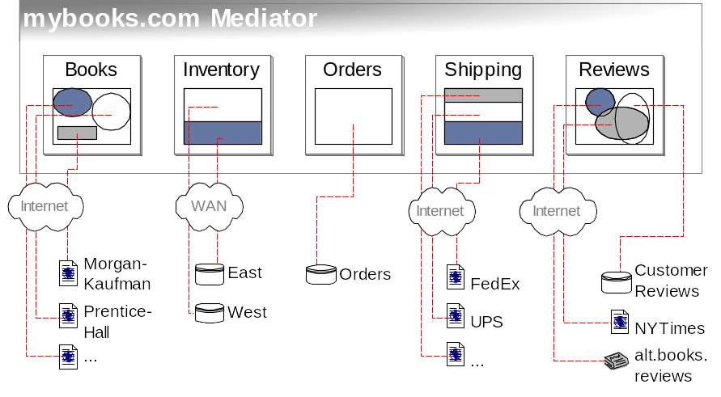
What is Data Integration?
Provide uniform access to data available in multiple, autonomous, heterogeneous and distributed data sources

Slide 3
Goals of Data Integration
Provide
  Uniform (same query interface to all sources)
  Access to (queries; eventually updates too)
  Multiple (we want many, but 2 is hard too)
  Autonomous (DBA doesn’t report to you)
  Heterogeneous (data models are different)
  Distributed (over LAN, WAN, Internet)
  Data Sources (not only databases).

Slide 4
Motivation
WWW
  Website construction
  Comparison shopping
  Portals integrating data from multiple sources
  B2B, electronic marketplaces
Science and culture
  Medical genetics: integrating genomic data
  Astrophysics: monitoring events in the sky.
  Culture: uniform access to all cultural databases produced by countries in Europe.

Slide 5
Hard Problem?
Is it a hard problem?
Why is it a hard problem?

Slide 6
Current Solutions
Ad-hoc programming: Create custom solutions for each application.
Data Warehouse
  Extract all the data into a single data source
Query
Data Warehouse
Data
Sources
Clean the data
Load Periodically

Slide 7
Problems with DW Approach
Data has to be cleaned – different formats
Needs to store all the data in all the data sources that will ever be asked for
  Expensive due to data cleaning and space requirements
Data needs to be updated periodically
  Data sources are autonomous – content can change without notice
  Expensive because of the large quantities of data and data cleaning costs

Slide 8
Virtual Integration
User Queries
Mediated schema
Reformulation engine
Mediator:
Optimizer
Data source
catalog
Execution engine
Wrapper
Wrapper
Wrapper
Data
Source
Data
Source
Data
Source

Slide 9
Architecture Overview
Leave the data in the data sources
For every query over the mediated schema
  Find the data sources that have the data (probably more than one)
  Query the data sources
  Combine results from different sources if necessary

Slide 10
Challenges
Designing a single mediated schema
  Data sources might have different schemas, and might export data in different formats
Translation of queries over the mediated schema to queries over the source schemas
Query Optimization
  No/limited/stale statistics about data sources
  Cost model to include network communication cost
  Multiple data sources to choose from

Slide 11
Challenges (2)
Query Execution
  Network connections unreliable – inputs might stall, close, be delayed, be lost
  Query results can be cached – what can be cached?
Query Shipping
  Some data sources can execute queries – send them sub-queries
  Sources need to describe their query capability and also their cost models (for optimization)

Slide 12
Challenges (3)
Incomplete data sources
  Data at any source might be partial, overlap with others, or even conflict
  Do we query all the data sources? Or just a few? How many? In what order?

Slide 13
Wrappers
Sources export data in different formats
Wrappers are custom-built programs that transform data from the source native format to something acceptable to the mediator
XML
HTML
<book>
<title> Introduction to DB </title>
<author> Phil Bernstein </author>
<author> Eric Newcomer </author>
<publisher> Addison Wesley </publisher>
<year> 1999 </year>
</book>
<b> Introduction to DB </b>
<i> Phil Bernstein </i>
<i> Eric Newcomer </i>
Addison Wesley, 1999

Slide 14
Wrappers(2)
Can be placed either at the source or at the mediator
Maintenance problems – have to change if source interface changes

Slide 15
Data Source Catalog
Contains meta-information about sources
  Logical source contents (books, new cars)
  Source capabilities (can answer SQL queries)
  Source completeness (has all books)
  Physical properties of source and network
  Statistics about the data (like in an RDBMS)
  Source reliability
  Mirror sources
  Update frequency

Slide 16
Schema Mediation
Users pose queries over the mediated schema
The data at a source is visible to the mediator is its local schema
Reformulation: Queries over the mediated schema have to be rewritten as queries over the source schemas
How would we do the reformulation?

Slide 17
Global-as-View
Mediated schema as a view over the local schemas
Mediated Schema: Movie(title, dir, year, genre)
Data Sources and local schemas:
S1[Movie(title,dir,year,genre)]
S2[Director(title,dir), Movie(title,year,genre)]
Create View Movie As
Select * from S1.Movie
Union
Select * from S2.Director, S2.Movie
where S2.Director.title = S2.Movie.title

Slide 18
Global-as-View(2)
Simply unfold the user query by substituting the view definition for mediated schema relations
Difficult to add new sources – All existing view definitions might be affected
Subtle issues – some information can be lost

Slide 19
Local-as-View
Local schemas as views over the mediated schema
Mediated Schema: Movie(title, dir, year, genre)
Data Sources and local schemas:
S1[Movie(title,dir,year,genre)]
S2[Director(title,dir), Movie(title,year,genre)]
Create Source S1.Movie As
Select * from Movie
Create Source S2.Movie As
Select title, year, genre from Movie
Create Source S2.Director As
Select title,dir from Movie

Slide 20
Local-as-View(2)
Query Reformulation
  Given a query Q over the mediated schema, and view definitions (sources) over the mediated schema, can we answer Q?
  Answering Queries Using Views
  Great Survey written by Alon

Slide 21
Which would you use?
Mediated Schema:
Movie(title, dir, year, genre)
Schedule(cinema, title, time)
Data Source
S3[Genres(cinema,genre)]
How would you do schema mediation using
Global-as-View? Local-as-View?
Can you answer this query in each case
Give me the cinema halls playing comedy movies

Slide 22
Query Optimization
Sources specify their capabilities if possible
  Transformation rules define the operations they can perform
  Sources might also specify cost models of their own
Cost model might be parametrized
  Mediator can estimate cost of transferring data by accumulating statistics from earlier transfers

Slide 23
Adaptive Query Processing
Adaptive query operators
  Aware that network communication might fail
Interleave Query Optimization and Execution
  Optimize query once with available limited statistics
  Execute the query for some time, collect statistics
  Re-optimize query again with improved statistics
  Resume execution… repeat

Slide 24
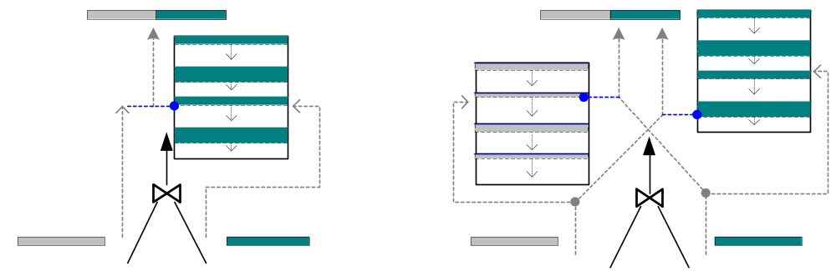
Double Pipelined Hash Join
Hash Join
Partially pipelined: no output until inner read
Asymmetric (inner vs. outer) — optimization requires source behavior knowledge
Double Pipelined Hash Join
Outputs data immediately
Symmetric — requires less source knowledge to optimize

Slide 25
Other Problems
Automatic Schema Matching
  How do I know what the view definitions are?
  Can I learn these definitions automatically?
Streaming Data
  The data is not stored in a data source, but is streaming across the network
  How do we query a data stream?

Slide 26
Other Problems(2)
Peer-to-Peer databases
  No clear mediator and data source distinction
  Each peer can both have data and fetch the rest of it
  Similar to Napster, Gnutella – except we want to share data that is not necessarily a single file

Slide 27
Bottom line
Data Integration is very exciting
Lots of opportunities for cool research
We do data integration at UW
We are working on number of projects
Are you interested?

Slide 28
References
Chapter 20 (Information Integration) of textbook. Sections 20.1 – 20.3
The Information Manifold Approach to Data Integration – Alon Levy, in IEEE Intelligent Agents, 1998

